Slide 1
CTR prediction
through cross-domain data from ads and news feeds
2022 DIGIX Global AI Challenge
Notes:
Presentation of my progress of the making prediction model
The CTR of ad when user browsing news
DigiX host by huawei

Slide 2
DATA

Slide 3
DATA
7,675,517 ~7.6M
35 features
User’s profiles: age, gender, residence, etc.
User’s device specs: size, version, etc.
User behavior logs: refresh time
Ad material info: creative type, what app is the ad in, who is the client of the ad, etc.

Slide 4
BASELINE

Slide 5
BASELINE
MODELS
Decision tree
Balanced random forest
XGBoost

Slide 6
Accuracy and Recall of the used Models
model | Decision Tree | Balanced Random Forest | XGBoost
accuracy | 0.98 | 0.98 | 0.98
recall | 0.19 | 0.20 | 0.00
Runtime For 7.6M data | ~6min | ~87min | ~35s
Notes:
accuracy doing well, but because Imbalanced

Slide 7
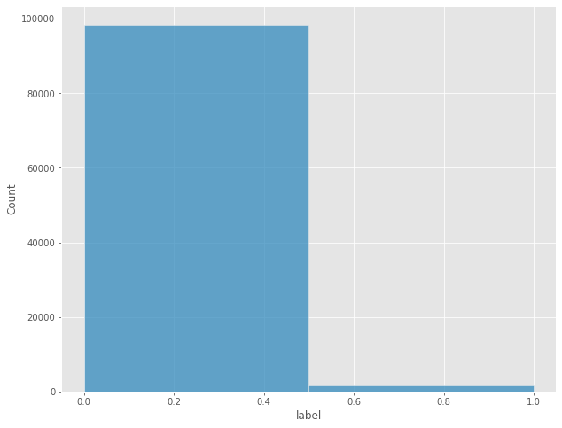
Imbalanced Data
98.4% | 1.56%
Google’s adWord performance:
3.17% on the search network
0.45% on the display network
Notes:
As a reference

Slide 8
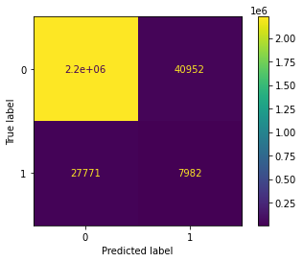
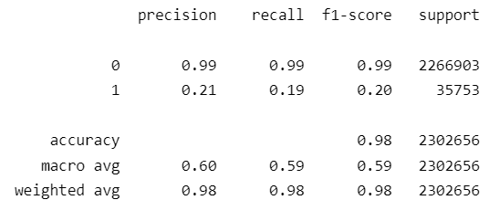
Decision tree
Notes:
Full data, default setting, 5 min
Subset, 100K, gridsearch, 6 min

Slide 9
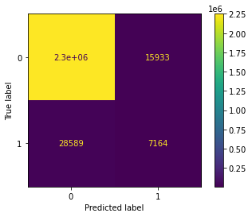
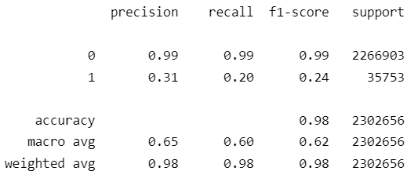
Balanced random forest
Notes:
with full data
87 MIN

Slide 10
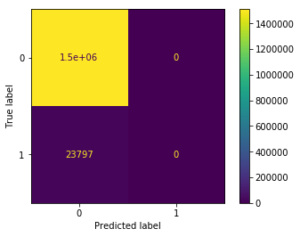
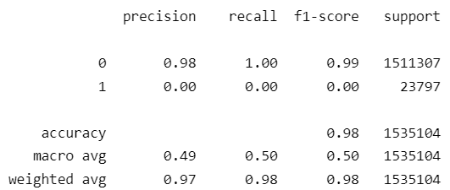
XGBOOST
Notes:
Even lower… T T

Slide 11
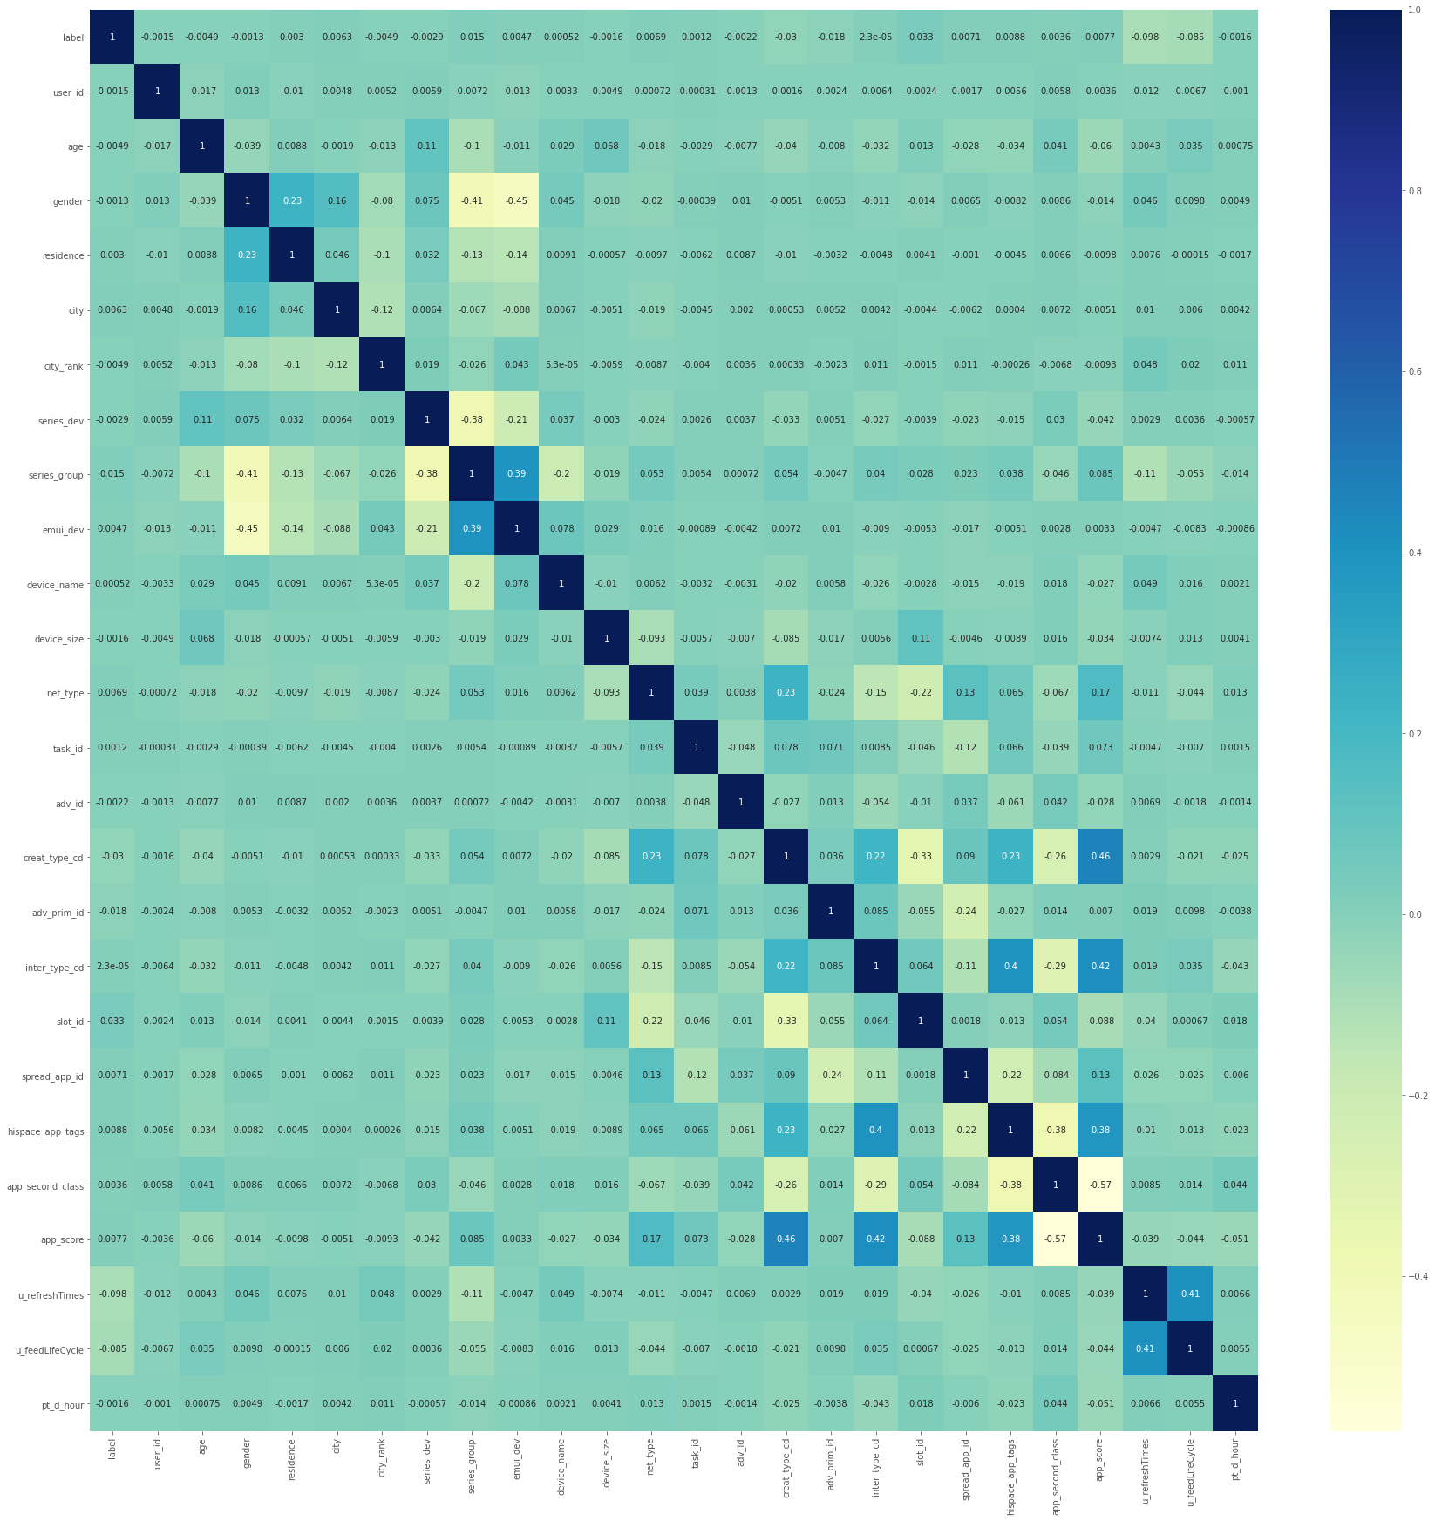
Another reason
Why the prediction is bad..
Not many obvious relationships
Notes:
Besides the imbalance, low correlation is another issue.
Maybe there are hidden connections

Slide 12
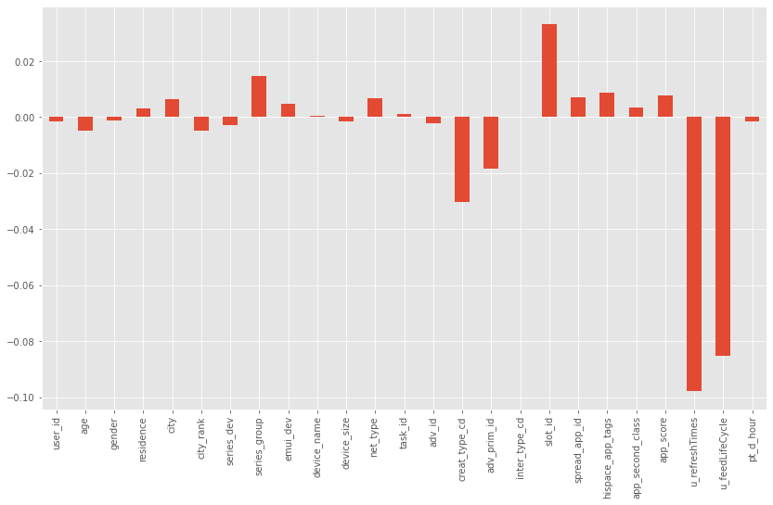
Some features are relatively correlated more
Refresh time
Device series
Creative id
Brand
Ad slot
Notes:
Try to find relatively correlated features, to try to find some hidden connections.

Slide 13
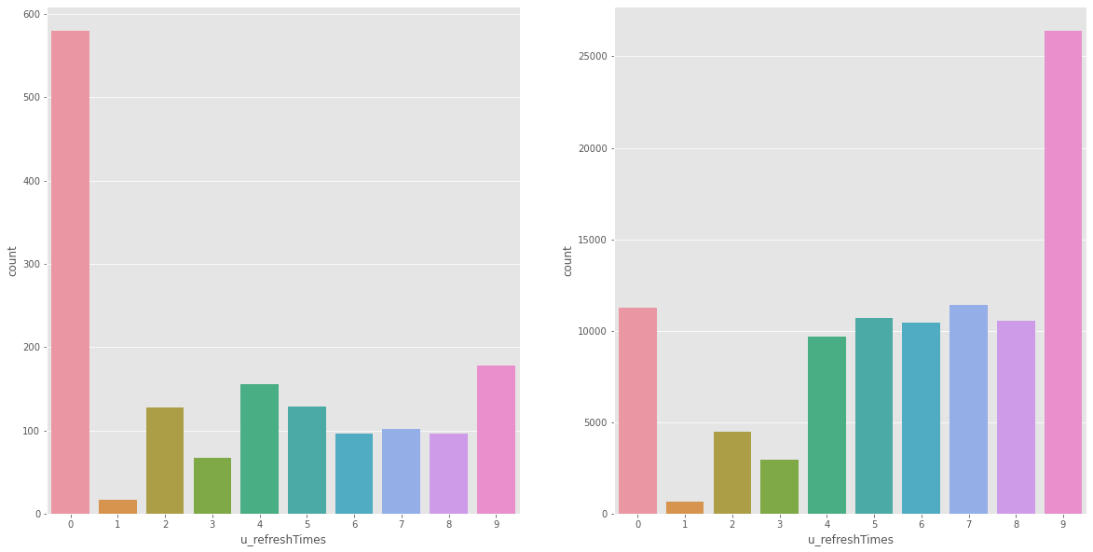
Distribution for refresh times | clicked vs not clicked
Refresh less, higher CTR
But IRL, many time user need to refresh many times.
Notes:
I assumed it’s related to users device condition.

Slide 14
Possible hidden connections
Some age group seems to click more
How many ad provided in the list
Certain brand or creative get more attention

Slide 15
FINAL MODEL
Notes:
After my magic tuning and feature engineering, here is my final model.

Slide 16
Accuracy and Recall of the used Models
model | Decision Tree | Decision Tree | XGBoost | XGBoost
 | before | after | before | after
accuracy | 0.98 | 0.91 | 0.98 | 0.98
recall | 0.19 | 0.24 | 0.00 | 0.13
Notes:
accuracy doing well, but because Imbalanced

Slide 17
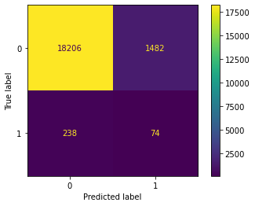
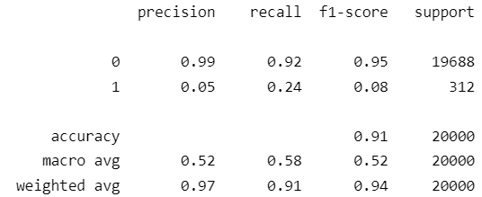
Decision tree
Keep the legit accuracy
Notes:
0.43 to 0.47, a little bit better
0.22 to 0.24

Slide 18

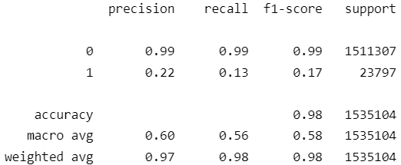
XGBOOST
Notes:
Even lower… T T

Slide 19
NEXT STEPS

Slide 20
PLAN
Add more features
Test on larger datasets
Test on more models
Neural network

Slide 21
Thanks for listening!
2022.10.7 Han Yan

